Slide 1

Sprocket Central Pty Ltd
Data analytics approach
[Division Name] - [Engagement Manager], [Senior Consultant], [Junior Consultant]

Slide 2
Agenda
Introduction
Data Exploration
Model Development
Interpretation

Slide 3
Introduction
Key Points / Features used for Analysis
Gender
Age Group
State
Job Title
Job Industry Category
Wealth Segment
Tenure
Property Valuation
Owns Car or Not
Past 3 Years Bike Related Purchases

Slide 4
Data Exploration
Dataset Information :
There are total 4 Datasets and their brief information about them is given below
Transactions (19997 Rows, 13 Columns)
Customer Demographic (3999 Rows, 12 Columns)
Customer Address (3999 Rows, 6 Columns)
New Customer List (1000 Rows, 23 Columns)

Slide 5
Model Development
Steps Involved in the Analysis :
First, we will clean our each datasets and remove any unwanted columns and duplicate records.
Next, we will create a new column Age using the DOB column.
Repeat the same step to create Age Group column from Age.
Next, we will create Profit column which will be our main focus of analysis.
Then we will merge our dataset on the basis of a common column.
Then we will create and analyze our data using various charts and graphs.
We will try to find out any patterns that are present which will reveal useful customer insights.
Those insights will be used to interpret the data from New Customer List.
Finally we will create a Dashboard in Tableau with all supporting charts and insights.

Slide 6
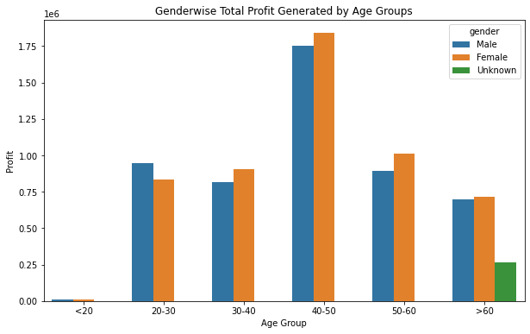
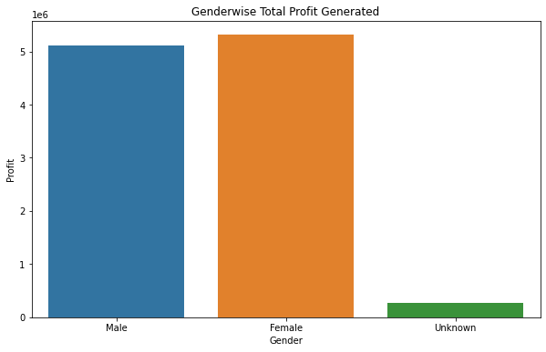
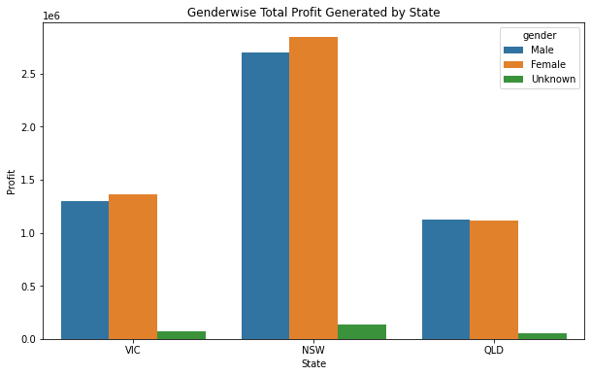
Interpretation
After analyzing below 3 Bar Charts, we came to following conclusions :
Both Males and Females have generated nearly equal profits.
People from Age Group 40 to 50 generated maximum profits
The State – New South Wales generated maximum profits.
So we should keep above points in mind when we select customers from new lists.

Slide 7
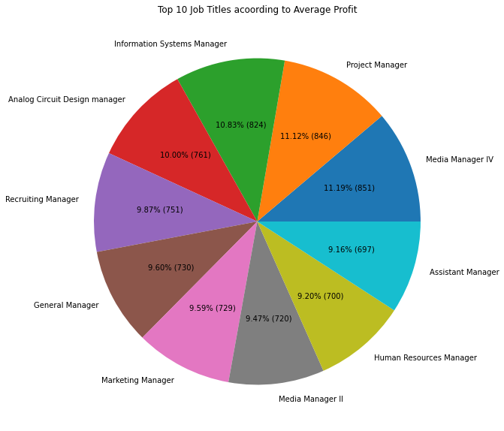
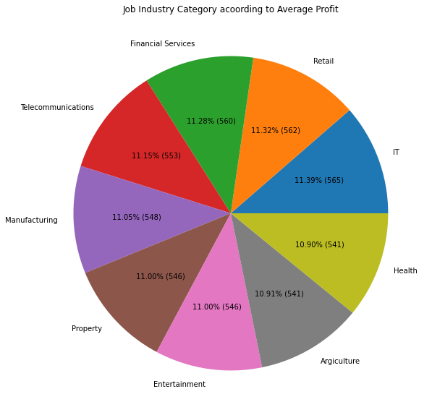
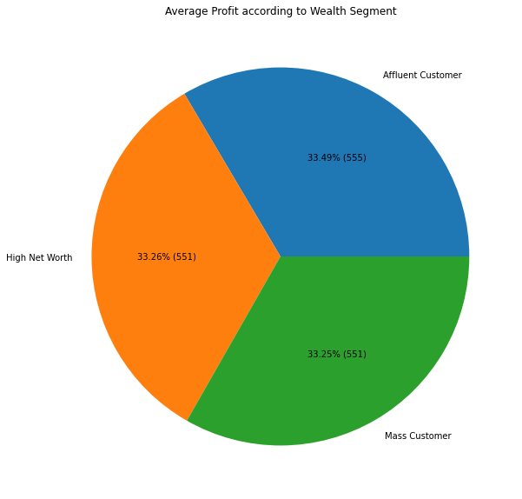
Interpretation
After analyzing below 3 Pie Charts, we came to following conclusions :
People with job titles Project Manager, Information System Manager generated maximum profits (see
Pie chart for top 10 job titles).
People working in Retail, Financial Services, Telecommunication are top 3 with maximum profits.
All the 3 Wealth Segments generated nearly equal profits.
So we should keep above points in mind when we select customers from new lists.

Slide 8
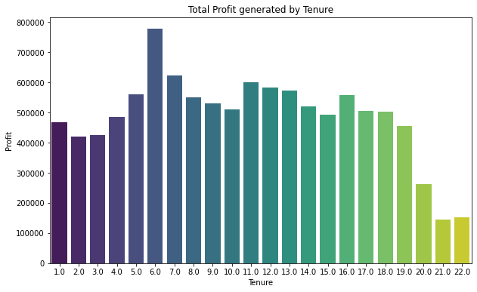
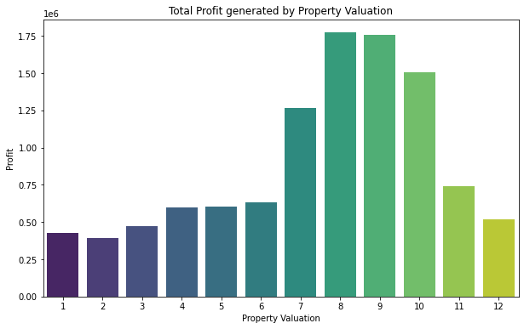
Interpretation
After analyzing below 2 Bar Charts, we came to following conclusions :
People with a Tenure between 5 to 8 and 11 to 13 generated maximum profits.
People with a Property Valuation between 7 to 10 generated maximum profits.
So we should keep above points in mind when we select customers from new lists.

Slide 9
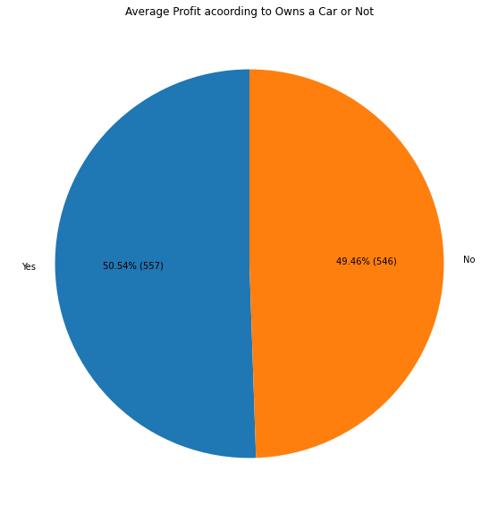
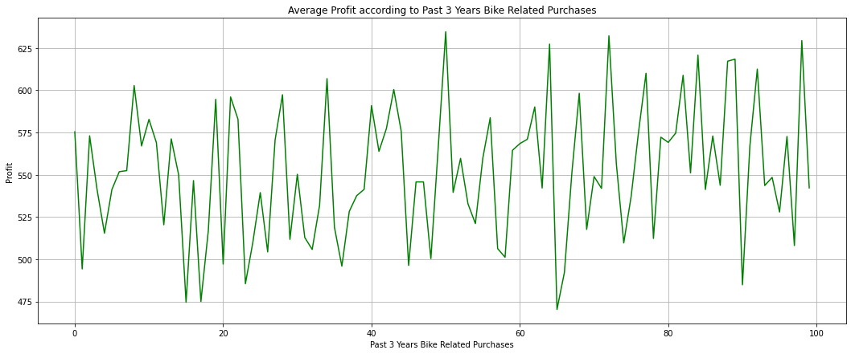
Interpretation
After analyzing below Pie and Line Chart, we came to following conclusions :
We should target people irrespective of having a Car or Not as below pie chart indicates they both resulted
in nearly equal profits.
People with Past 3 Years Bike Related Purchases around 50 to 70 generated a good profit.
So we should keep above points in mind when we select customers from new lists.

Slide 10
Note: The data and information in this document is reflective of a hypothetical situation and client. This document is to be used for KPMG Virtual Internship purposes only.
Thank You

